Slide 1
Data Structure Lab 5 Stacks CSCI207

Slide 2
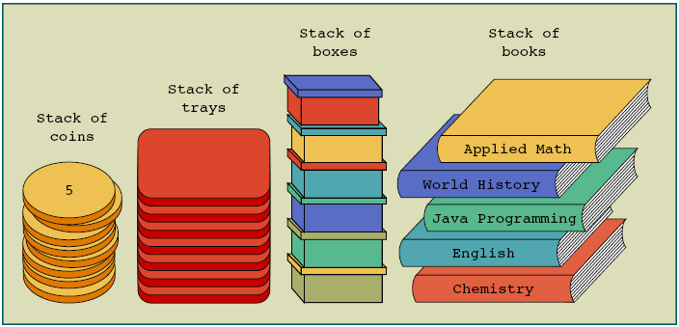
Stacks

Slide 3
Stacks
Stacks are also called Last In First Out (LIFO) data structures
Operations performed on stacks
Push: adds an element to the stack
Pop: removes an element from the stack
Peek: looks at the top element of the stack

Slide 4
Stack Representation LIFO
Clear()
Pop()
S
Peek()?
Push(10)
Push(8)
Push(5)
8
10
8
5
Notes:
Last in first out

Slide 5
Let’s implement
First we need to create class stack that has members:
Size : int → the max size you need
Top : int → the last element in the stack
List : array of int values(or any data type we need)
Default constructor
Set size = 100
Set top = -1 → that refer to the stack is empty
Create list of size 100

Slide 6
Let’s implement
Parameterized constructor that take size parameter
Set size = the size you got from parameter
Set top = -1 → that refer to the stack is empty
Create list it's size that you got from parameter
Initialization function → to initialize all element of list
Push function → to add new element
Pop function → return the last element and delete it
Peek function → just return last element
Clear function → remove all element

Slide 7
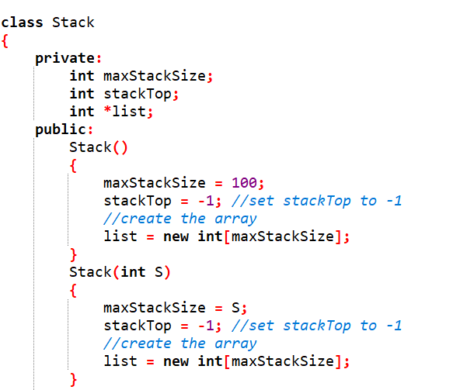
Let’s implement

Slide 8
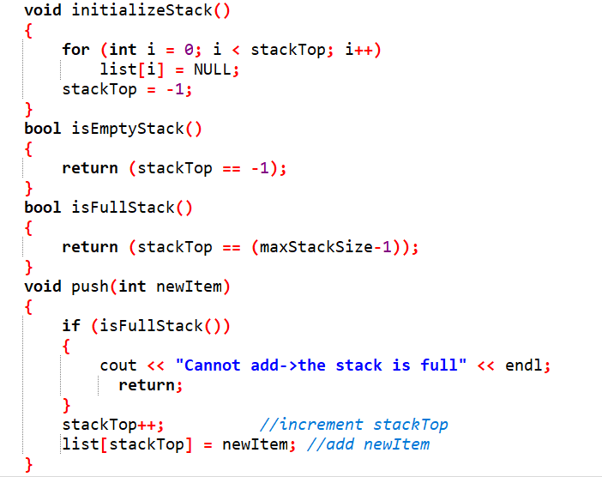
Let’s implement

Slide 9
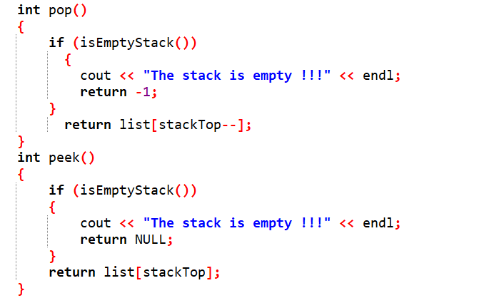
Let’s implement

Slide 10
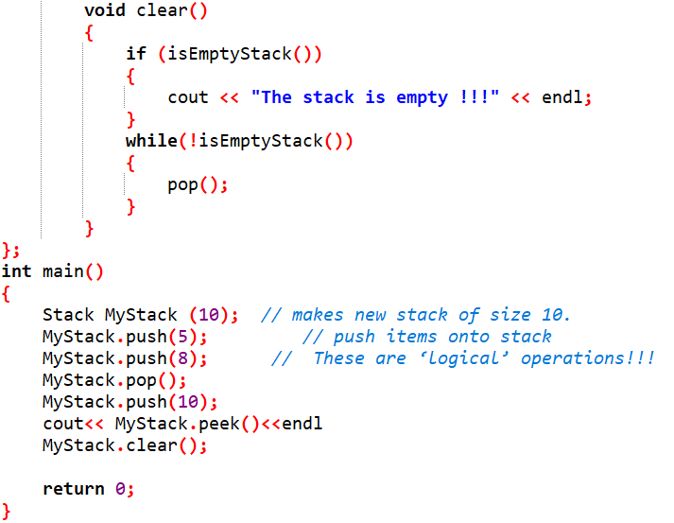
Let’s implement

Slide 11
Task : DECIMAL TO BINARY CONVERTER
Implement a function that takes input parameters (decimal number) and works on it using Stack to convert it into a binary number.
EX: to convert 8 to binary
8 /2 →4 with reminder 0
4/2 → 2 with reminder 0
2/2 → 1 with reminder 0
1/2 → 0 with reminder 1
So 8 become 1000
S
1
0
0
0

Slide 12
THANK YOU

